Slide 1
My education/profession

Slide 2
What would you like to do ?
¿Que te gustaria hacer?

Slide 3
What do you plan to do?
¿Que piensas hacer?

Slide 4
I am interested in studying…
Estoy interesado(a) en estudiar

Slide 5
I have always wanted to study…
Siempre he querido estudiar ….

Slide 6
I would like to be
Me gustaría ser…

Slide 7
I intend to…
pienso

Slide 8
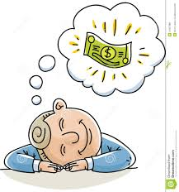
I dream of …
Sueño en/ con…

Slide 9
profession
profesión

Slide 10
Service industry
Sector de servicios

Slide 11
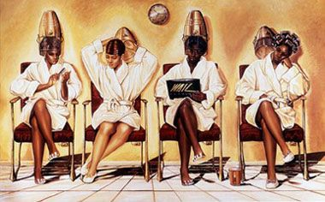
beautician
estetiscista

Slide 12
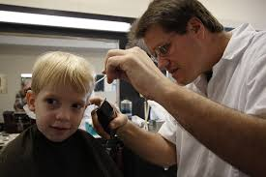
barbero
barber

Slide 13
negocio
business

Slide 14
Empresario(a)
Entrepreneur

Slide 15
Gerente
manager

Slide 16
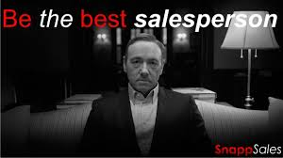
Vendedor(a)
Sales person

Slide 17
soldado
soilder

Slide 18
Medicina
medicine

Slide 19
Doctor
doctor

Slide 20
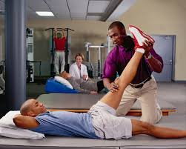
fisioterapeuta
Physical therapist

Slide 21
Enfermero(a)
nurse

Slide 22
Investigador
Investigator/ researcher

Slide 23
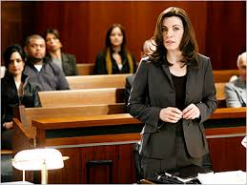
abogado
lawyer

Slide 24
Asistente legal / jurídico
paralegal

Slide 25
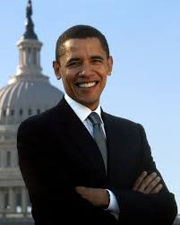
politico
politician

Slide 26
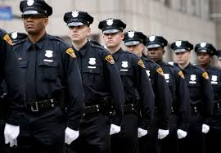
Oficial de policía
Police officer

Slide 27
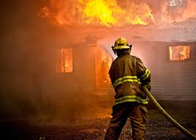
Bombero
firefighter

Slide 28
Educación
education

Slide 29
Director(a)
principal

Slide 30
Consejero(a)
counselor

Slide 31
Profesor(a)/ maestro(a)
teacher

Slide 32
Escritor
writer

Slide 33
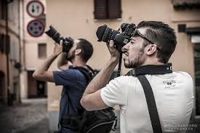
Fotógrafo(a)
photographer

Slide 34
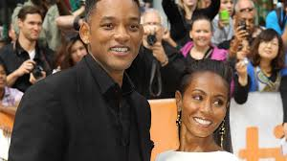
Actor/actriz
actor,/ actress

Slide 35
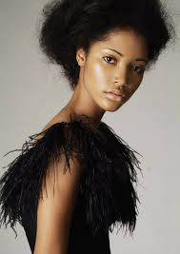
modelo
model

Slide 36
La estrella del programa de la vida real
Reality tv star

Slide 37
Convertirse en
To become

Slide 38
Conseguir(obtener) trabajo
To get a job

