Slide 1
Objetos Indirectos Día 1
What is a subject?
It’s the person or object doing the action.
Ejemplo: I throw the ball.
What is a direct object?
It’s the person or object receiving the action.
Ejemplo: I throw the ball. (the ball does nothing, something is done to it)
What is an indirect object? Tell to whom or for whom
It gets the benefit of the action.
Ejemplo: I throw the ball to you. (you aren’t throwing nor are you thrown, the throwing is done for your benefit.)

Slide 2
Objetos Indirectos Día 1
Is this a subject, a direct object, or an indirect object
Señora Cooper gives me homework
indirect object
I study Spanish.
direct object
I watch TV for my film and video class.
direct object
I say my vocab words to you.
indirect object
It gives me great pleasure to meet you.
indirect object

Slide 3
Objetos Indirectos Día 1
It gives me great pleasure to meet you.
indirect object
Remember “gustar” means “to give pleasure/enjoyment to.” That means you’ve already met the indirect object pronouns. Indirect objects are for whom or to whom!!!
me
nos
te
le
les

Slide 4
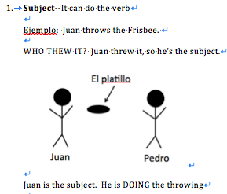
Objetos Indirectos Día 1
There are 3 basic relationships a noun can have to a verb

Slide 5
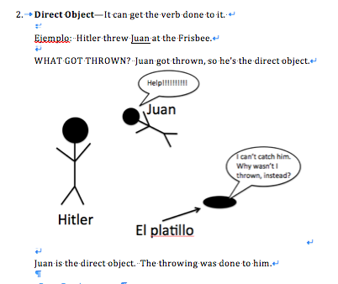
Objetos Indirectos Día 1
There are 3 basic relationships a noun can have to a verb

Slide 6
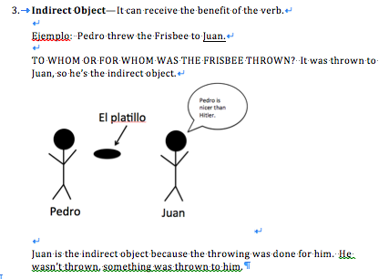
Objetos Indirectos Día 1
There are 3 basic relationships a noun can have to a verb

Slide 7
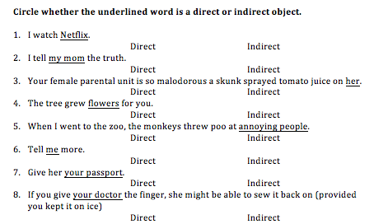
Objetos Indirectos Día 1

Slide 8
What word replaces the underlined
la señora Cooper da la tarea a mí.
me
los estudiantes hablan a señora Cooper.
le
yo doy la televisión a mi mamá.
le
Digo las palabras a tí.
te
A Fred ____ gusta correr.
le
Me da la tarea.
Le hablan.
Yo Le doy la television.
Te digo las palabras.
Le gusta correr.

Slide 9
Objetos Indirectos Día 1
Placement
Just like direct object pronouns, indirect object pronouns can go immediately ____________ a conjugated verb or ____________ to an unconjugated verb.
Pagina 47 ex. 12
before
attached

