Slide 1
How to use wevideo and make a video project.

Slide 2
1st download WEVIDEO… ITS AN APP AND ITS FREE. When you open it looks like this

Slide 3
Click the + sign at bottom right to start a new project.

Slide 4
click title and rename it to what you need to … Hice un viaje or mi vida loca or whatever the title is of the project

Slide 5
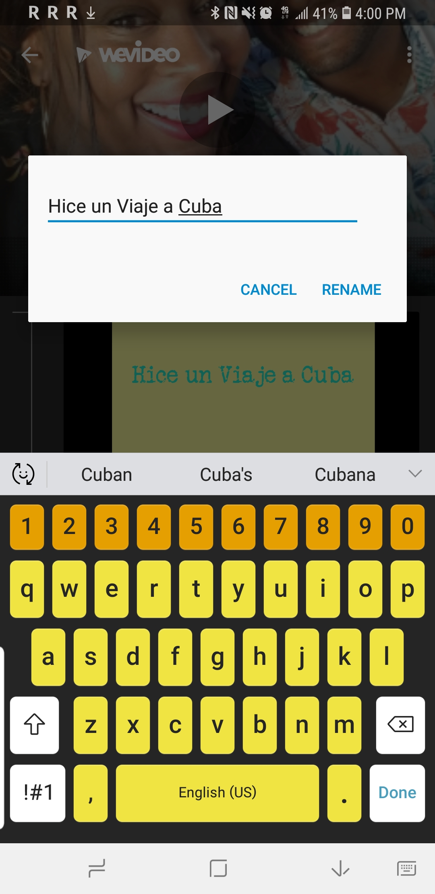
click video and rename it as well to hice un viaje a ... Or mi vida loca or what ever the name of the project is

Slide 6
Adjust text size and placement

Slide 7
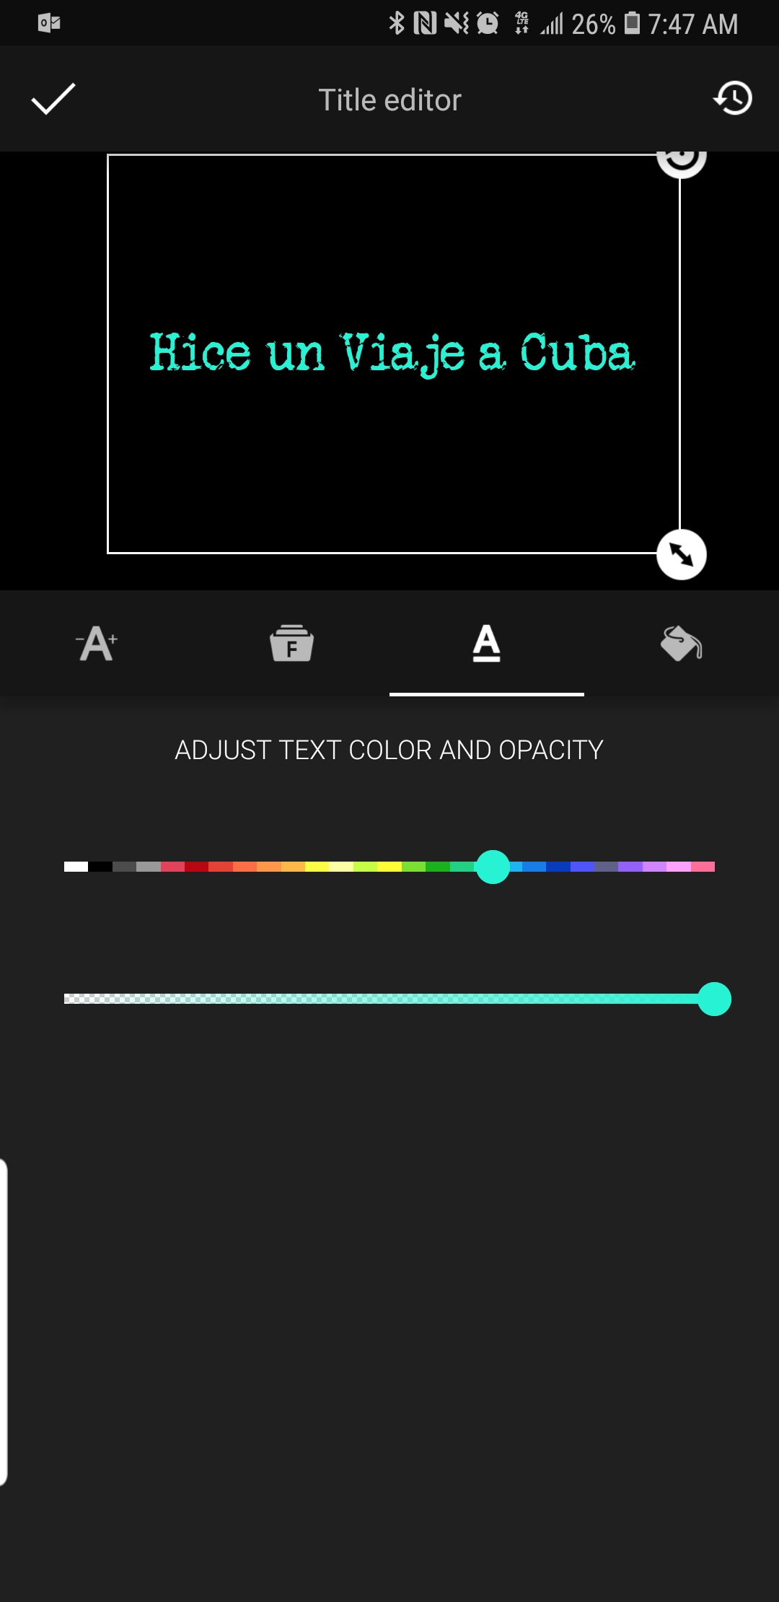
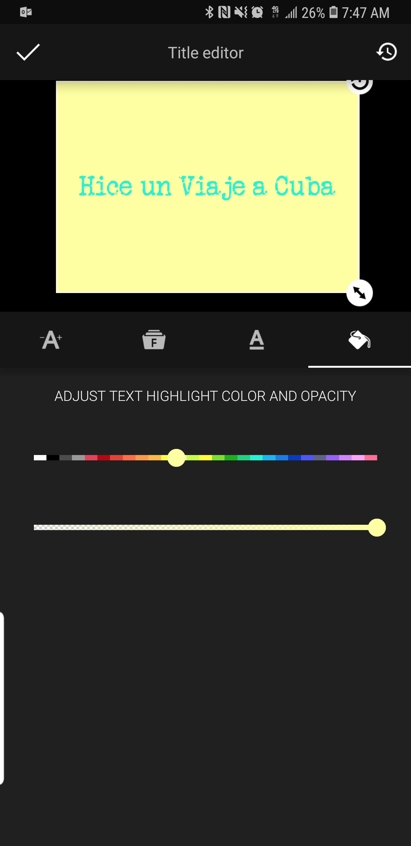
Adjust font style , text color and background color

Slide 8
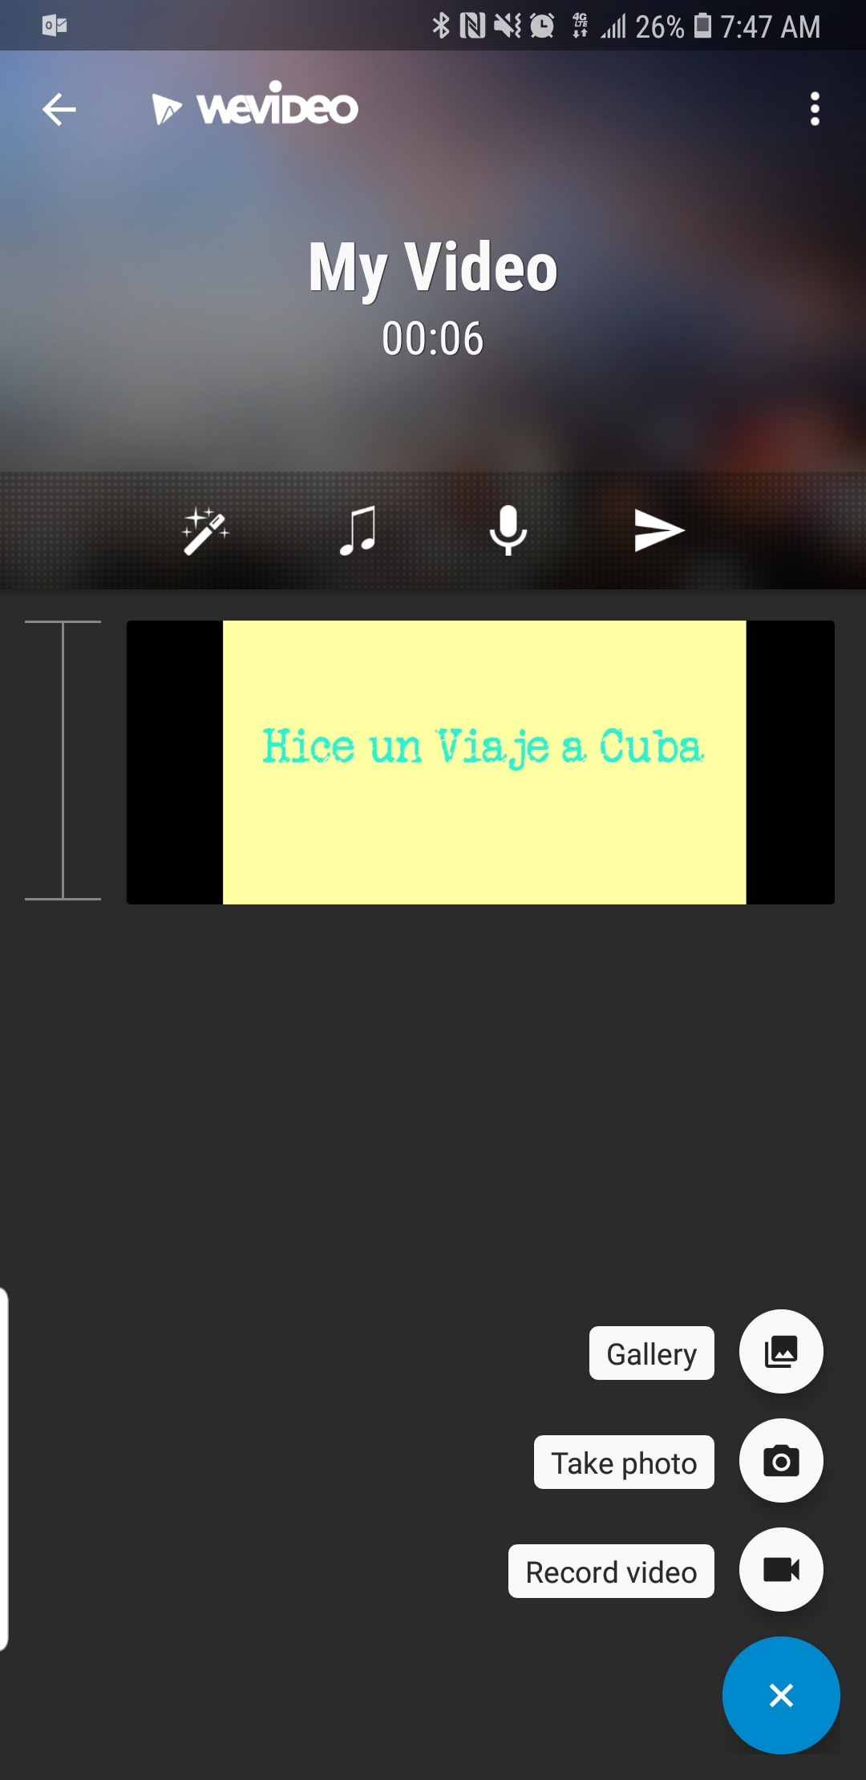
Click the arrow on the bottom right again to add content. You can choose from the gallery , take a photo or record video. You are going to choose Gallery. It is best if you already have all the pictures/video you are going to use in an album in your gallery/camera roll

Slide 9
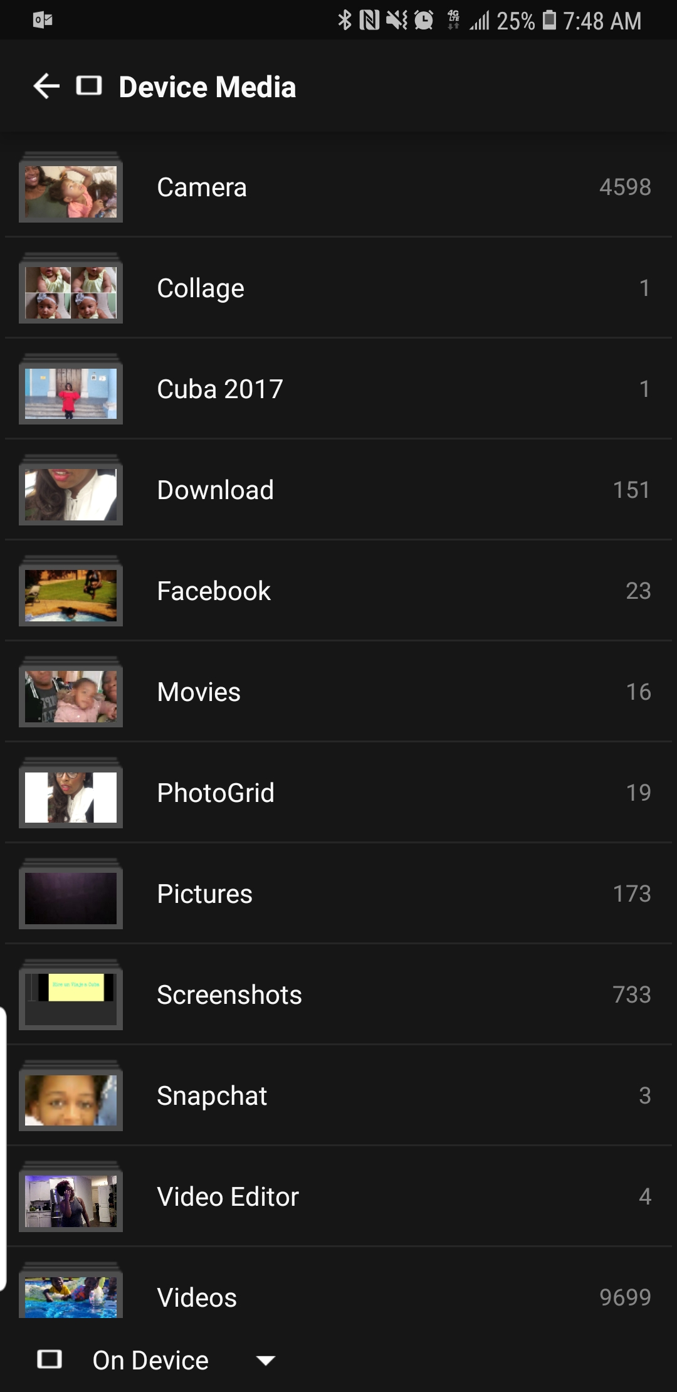
Click the arrow on the bottom right again to add content. You can choose from the gallery , take a photo or record video. You are going to choose Gallery. It is best if you already have all the pictures/video you are going to use in an album in your gallery/camera roll

Slide 10
Choose all the photos you want to use then click the green check mark.

Slide 11
Your project will look like this once you have selected all photos. The first tool on the tool bar at the top is for themes, I did not use a theme on my video but you can if you would like.

Slide 12
Your project will look like this once you have selected all photos. Choose the microphone on the tool bar at the top to do your voice over.

Slide 13
Click allow, it will ask for permission. I will do this when you add photos for the first time as well.

Slide 14
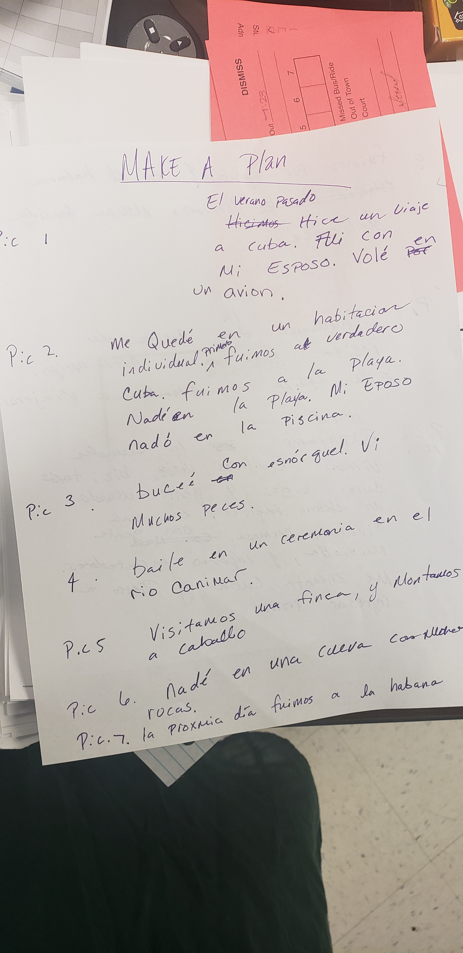
Click the red record button the pictures will play as you record so that you know what you are saying for each picture/ video. Make sure you have a plan!!! On what you are going to say. You are going to give Sra. Cooper this plan so that I can follow along easier. Once done click the check mark at top left.

Slide 15
Make sure your voice over volumn is up loud enough

Slide 16
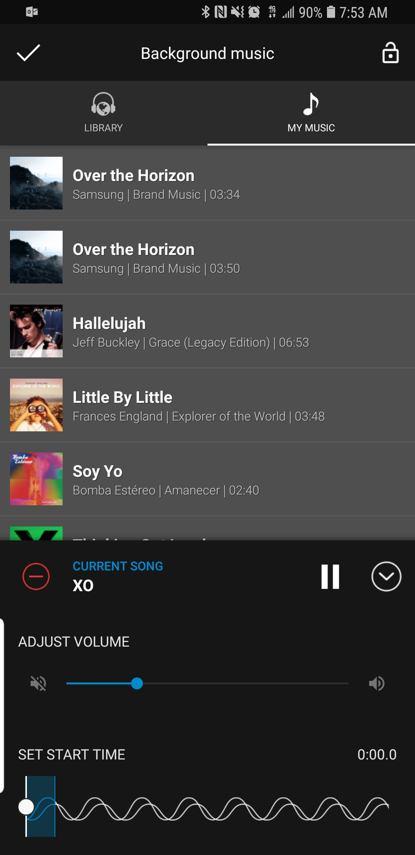
Next click the music note if you would like to add music. On the top you an choose my music or library the app has some mood instrumental songs if you choose my music you can choose music on your phone it has to be music that is downloaded on your phone. Please choose appropriate music no cursing. Notice at the bottom you can adjust volume!! make sure you turn it down, so that it does not drown out your speaking , you can also set the start time of the song. Test it out!

Slide 17
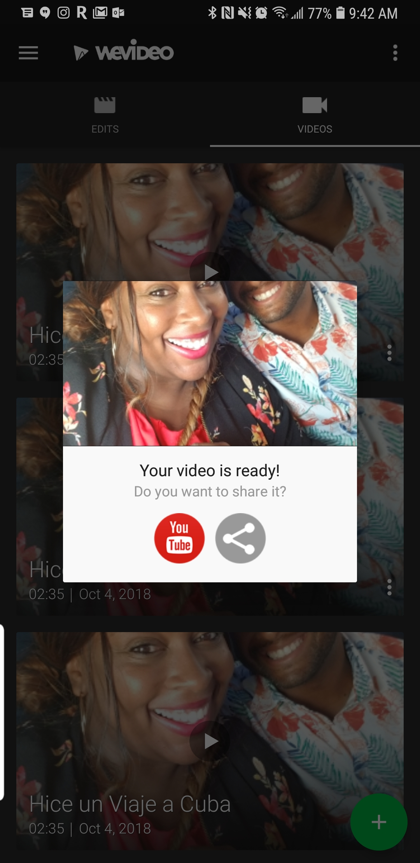
1st test it out make sure you do not need to adjust the sound on the voice over or the music. Then save and share your project. By pushing the send arrow. The video will save then ask if you want to share it. To you tube or somewhere else. You can do either one. If you choose youtube make sure you send the link to my email with your name on it

Slide 18
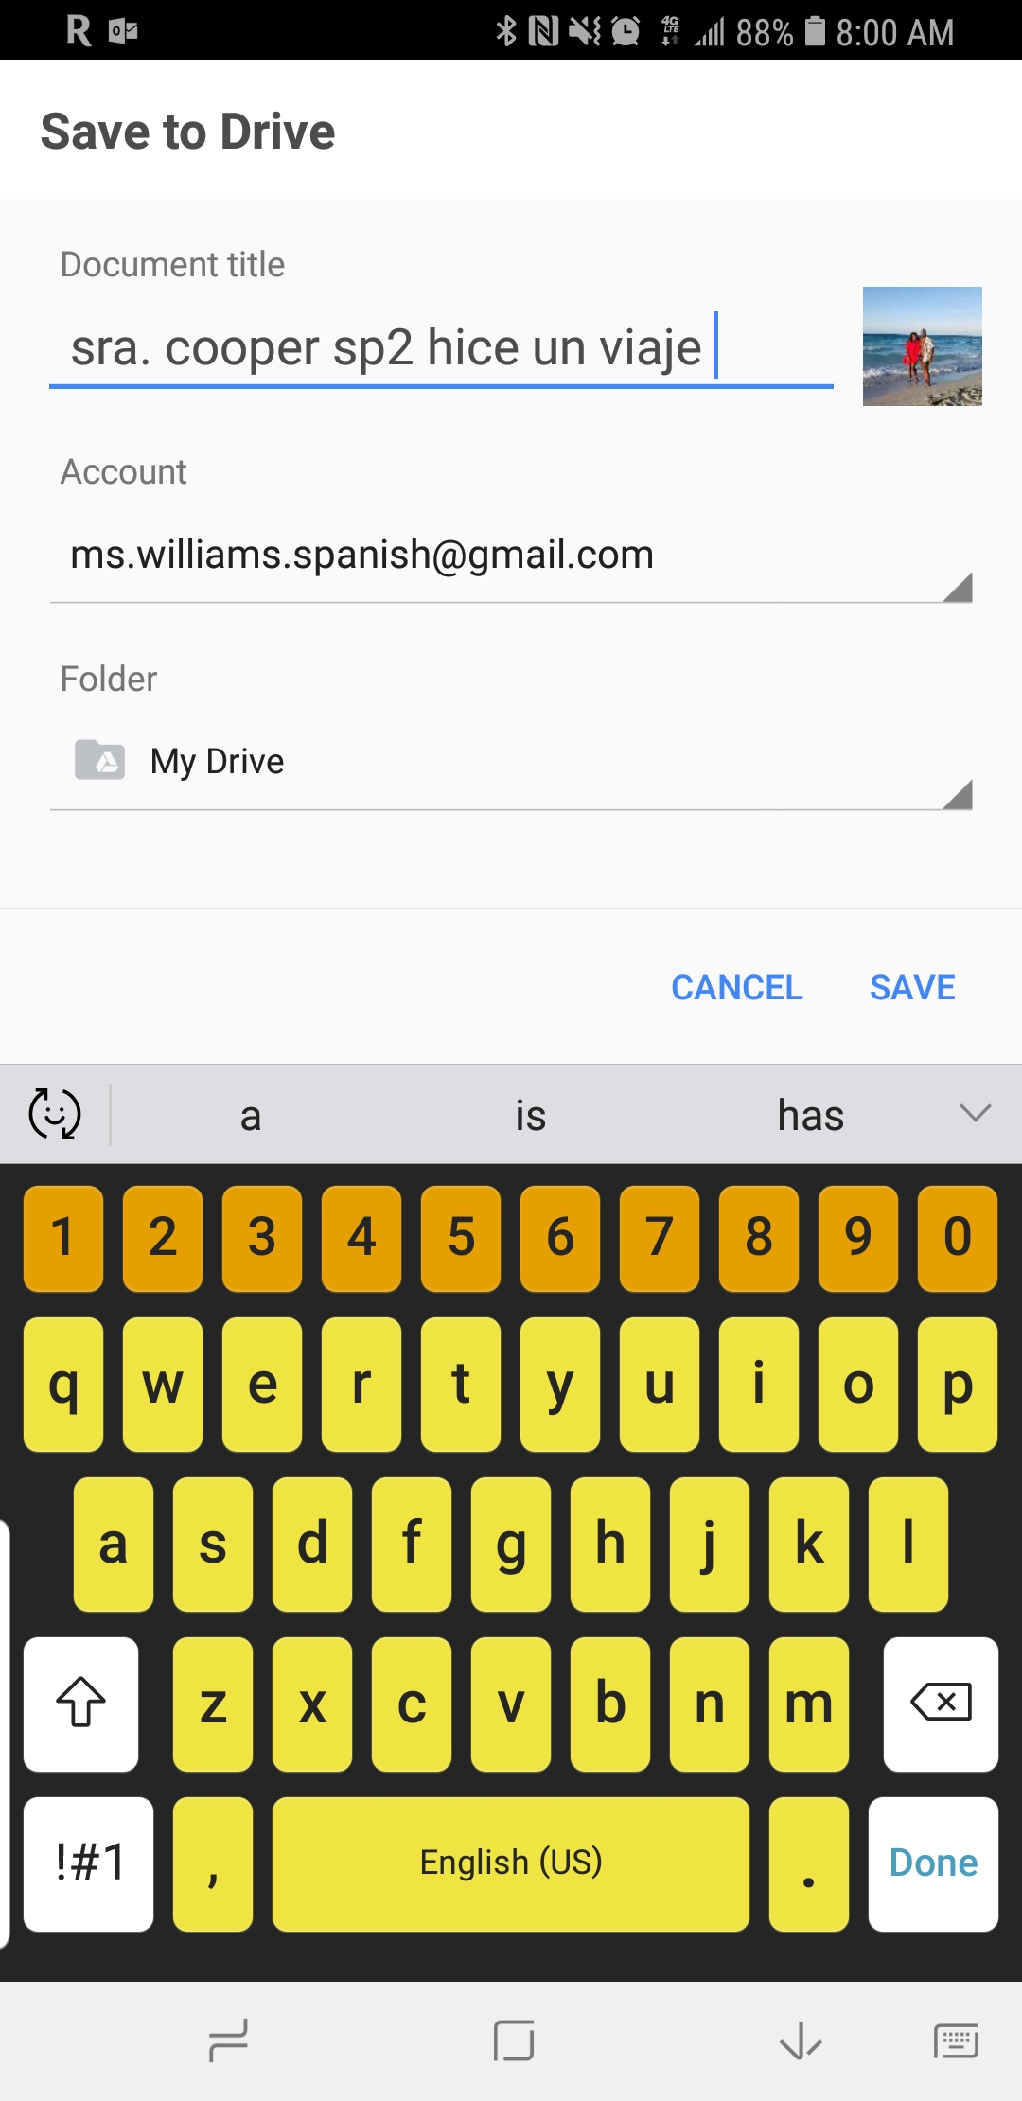
Click the other share button and it will look like this. Choose save to drive you must have this app downloaded on your phone to choose this option this option puts the project in your email. Make sure you put your name class period and name of project and click save.

Slide 19
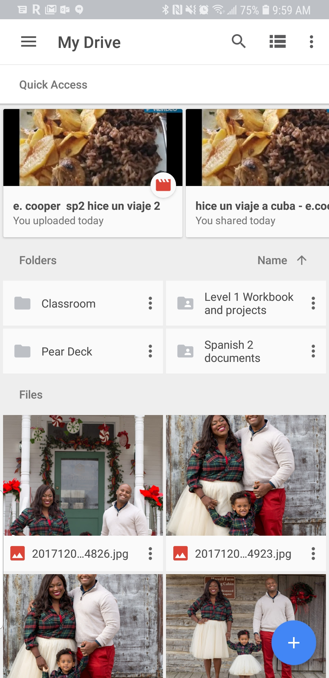
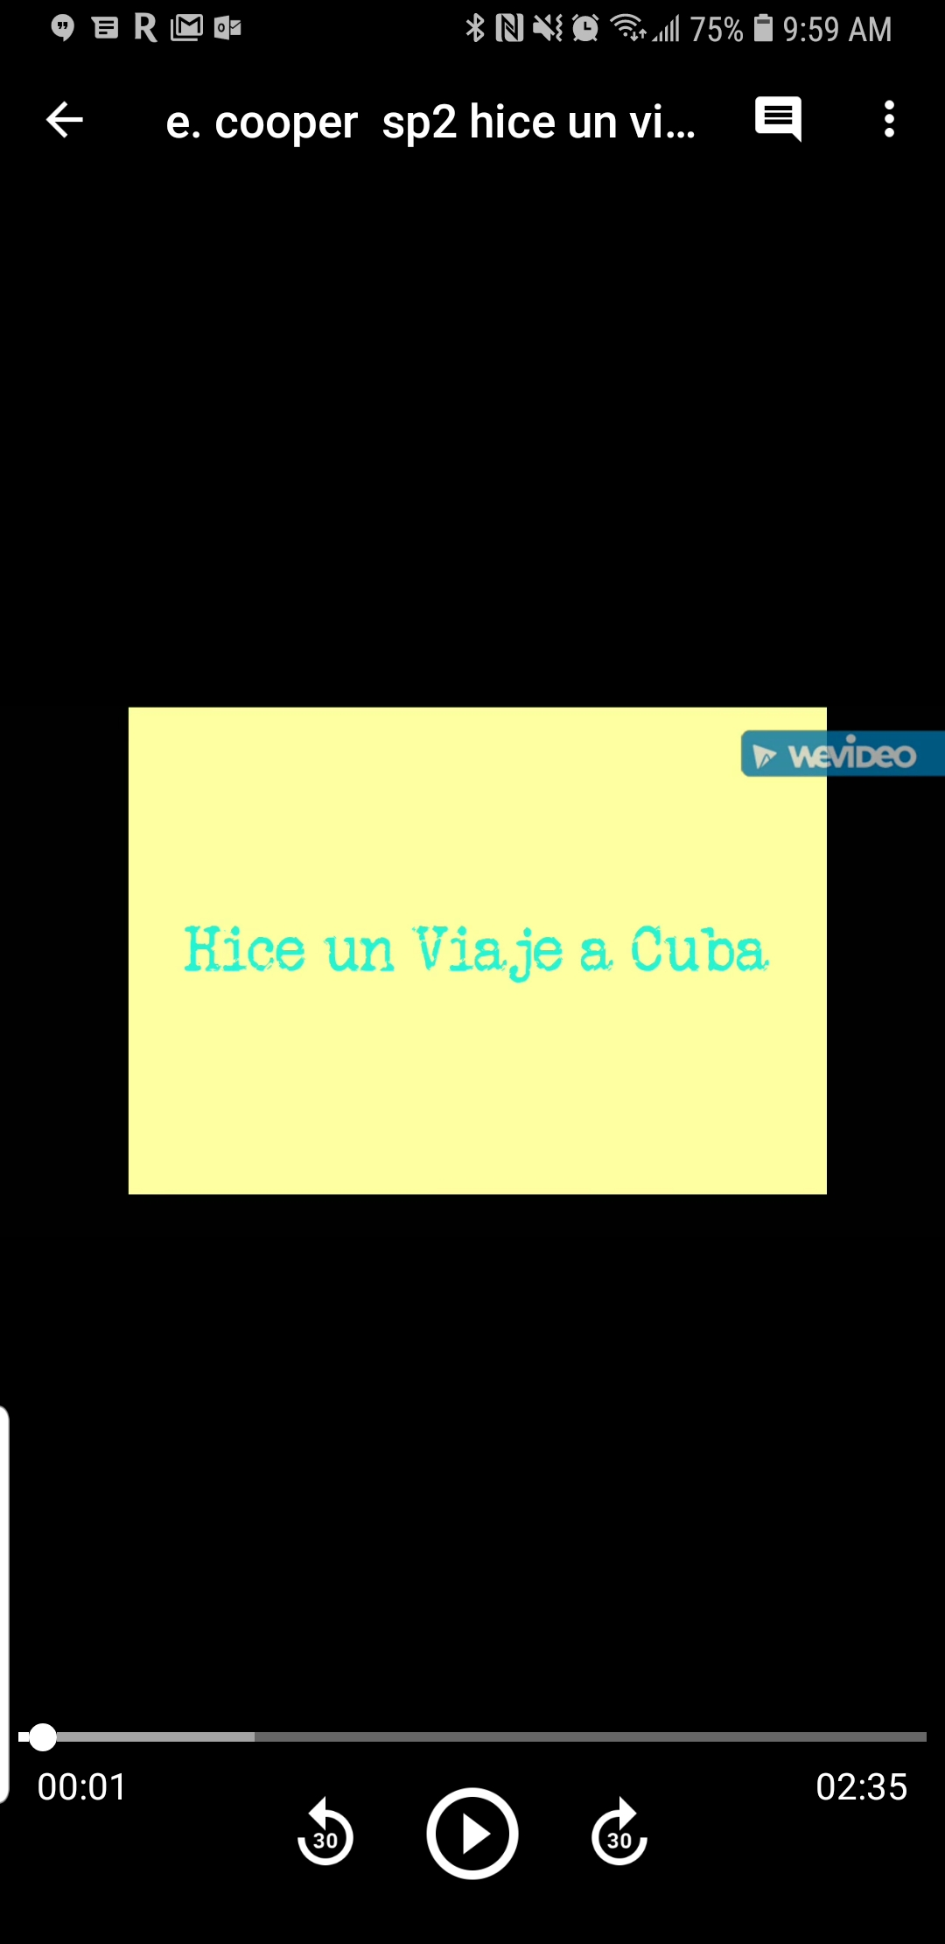
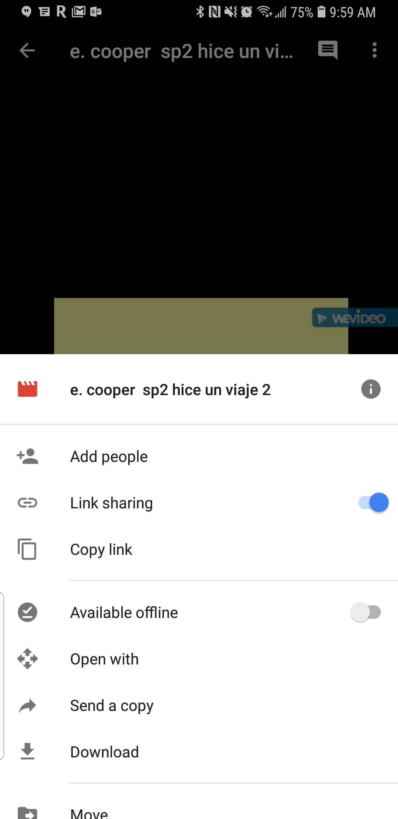
Now go to the google drive app on your phone you should see your project there. Open it. Click the 3 dots on the top right of the screen, make sure link sharing is on and copy link you will send an email to me with this link in it with your name on it, And wala you are done.

