Slide 1
Demonstrative Pronouns Día 1
Objetivo: Estudiantes van a saber usar los pronombres demostrativos.
Standard Addressed:
1.1 In the target language, engage in conversations, provide and obtain information, express feelings and emotions, and exchange opinions.
4.1 Demonstrate understanding of the nature of language through comparisons of the language studied and their own.
Calentamiento: (5 min)
Cinco personas que juegan básquetbol juntos son un _________.
Si como verduras y hago ejercicio, voy a estar ________.
El señor Gore va a los partidos de fútbol americano de GHS, pero no juega. Es un __________.
equipo
sano
aficionado
Notes:
Hit #8 Activating Prior Knowledge

Slide 2
Demonstrative Pronouns
Demonstrative pronouns and demonstrative adjectives demonstrate which one we’re talking about (this/that/etc.)
They go before the noun they describe, or take the place of the noun entirely. USE OF ACCENT MARKS TELLS YOU WHICH IS BEING USED. Ejemplo: Yo quiero este pastel. (adj.) Yo quiero éste. (pronoun)
The demonstratives are divided based on proximity. (close to speaker, not close, far away)
Notes:
Hit #8 Activating Prior Knowledge

Slide 3
Close to speaker
(this and these have T’s)
ADJECTIVES
 | Masculine | Feminine
Singular | Este | Esta
Plural | Estos | Estas
PRONOUNS
 | Masculine | Feminine
Singular | Éste | Ésta
Plural | Éstos | Éstas
Notes:
Hit #8 Activating Prior Knowledge

Slide 4
Not close to the speaker
(often seen as close to the listener)
ADJECTIVES
 | Masculine | Feminine
Singular | Ese | Esa
Plural | Esos | Esas
PRONOUNS
 | Masculine | Feminine
Singular | Ése | Ésa
Plural | Ésos | Ésas
Notes:
Hit #8 Activating Prior Knowledge

Slide 5
Far away
ADJECTIVES
 | Masculine | Feminine
Singular | Aquel | Aquella
Plural | Aquellos | Aquellas
PRONOUNS
 | Masculine | Feminine
Singular | Aquél | Aquélla
Plural | Aquéllos | Aquéllas
Notes:
Hit #8 Activating Prior Knowledge

Slide 6
Demonstratives
On your whiteboard, label the item using both a demonstrative adjective AND the noun.
Ejemplo:
Este libro
5 cm

Slide 7
Demonstratives
On your whiteboard, label the item using both a demonstrative adjective AND the noun.
Ese libro
5 m

Slide 8
Demonstratives
On your whiteboard, label the item using both a demonstrative adjective AND the noun.
Aquel libro
50 m

Slide 9
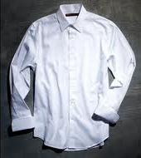
Demonstratives
On your whiteboard, label the item using both a demonstrative adjective AND the noun.
Aquella camisa
50 m

Slide 10
Demonstratives
On your whiteboard, label the item using both a demonstrative adjective AND the noun.
Esa camisa
5 m

Slide 11
Demonstratives
On your whiteboard, label the item using both a demonstrative adjective AND the noun.
Esta camisa
5 cm

Slide 12
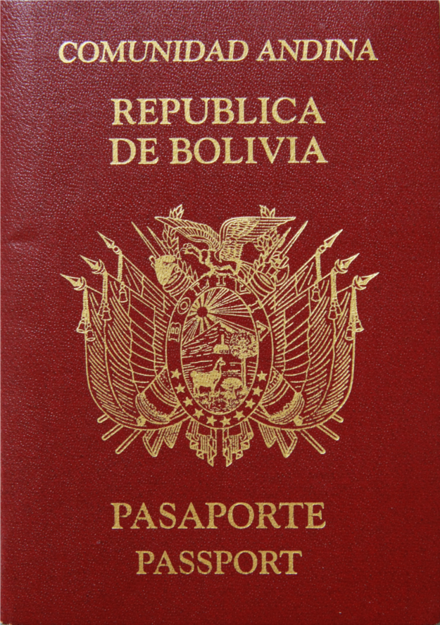
Demonstratives
On your whiteboard, label the item using both a demonstrative adjective AND the noun.
Este pasaporte
5 cm

Slide 13
Demonstratives
On your whiteboard, label the item using both a demonstrative adjective AND the noun.
Ese pasaporte
5 m

Slide 14
Demonstratives
On your whiteboard, label the item using both a demonstrative adjective AND the noun.
Aquel pasaporte
50 m

Slide 15
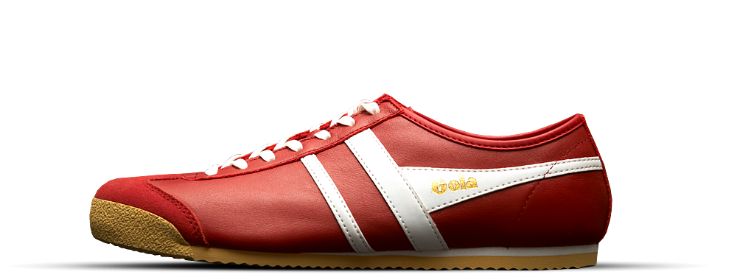
Demonstratives
On your whiteboard, label the item using both a demonstrative adjective AND the noun.
Este zapato
5 cm

Slide 16
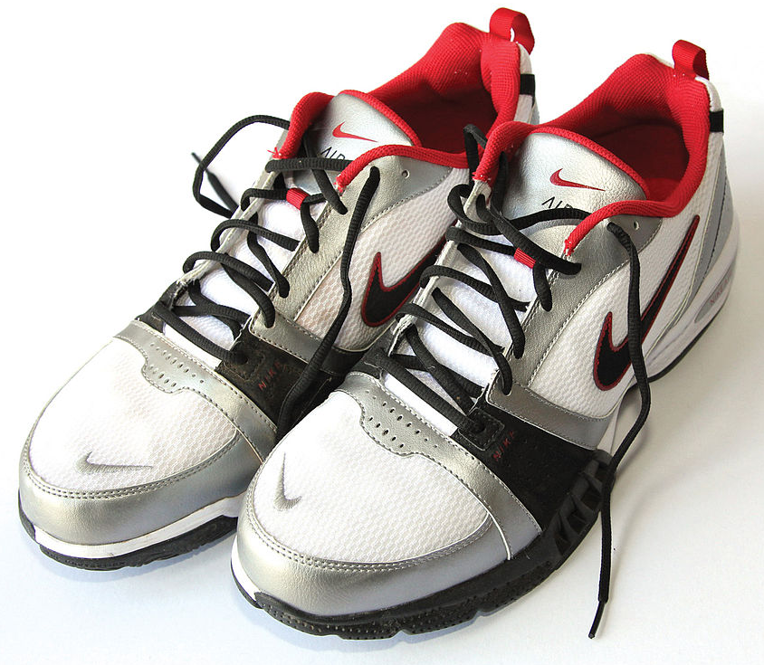
Demonstratives
On your whiteboard, label the item using both a demonstrative adjective AND the noun.
Esos zapatos
5 m

Slide 17
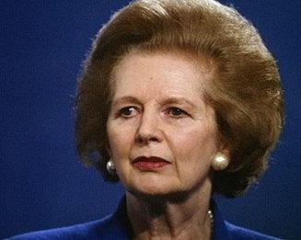
Demonstratives
On your whiteboard, label the item using both a demonstrative adjective AND the noun.
Aquella mujer
50 m

Slide 18
Demonstratives
On your whiteboard, label the item using both a demonstrative adjective AND the noun.
Estas mujeres
5 cm

Slide 19
Demonstratives
On your whiteboard, label the item using both a demonstrative adjective AND the noun.
Aquellas mujeres
50 m

Slide 20
Demonstratives
On your whiteboard, label the item using both a demonstrative adjective AND the noun.
Aquel zapato
50 m

Slide 21
Demonstratives
On your whiteboard, label the item using both a demonstrative adjective AND the noun.
Estos zapatos
5 cm

Slide 22
Demonstratives
On your whiteboard, label the item using both a demonstrative adjective AND the noun.
Esas mujeres
5 m

Slide 23
Demonstratives
On your whiteboard, label the item using both a demonstrative adjective AND the noun.
Esta mujer
5 cm

Slide 24
Demonstratives
On your whiteboard, label the item using both a demonstrative adjective AND the noun.
Aquellos zapatos
50 m

Slide 25
Demonstratives
On your whiteboard, label the item using both a demonstrative adjective AND the noun.
Ese zapato
5 m

Slide 26
Demonstratives
On your whiteboard, label the item using both a demonstrative adjective AND the noun.
Esa mujer
5 m

Slide 27
Demonstratives
On your whiteboard, complete the blanks
esta
No me gusta ______ camisa que llevo.
En la cafetería hay una pizza. ________ pizza no es rica. Es como si fuera de plástico. ¡Guácala!
Tu lápiz no sirve. _______ es mejor. ¡Tenlo!
Hoy es un día muy difícil. _______ son los tiempos que pesan los almas humanos.
Allá, es ________ cosa.
Aquí los tengo. _________ son los mejores.
Aquella
Éste
Éstos
esa
Éstos

Slide 28
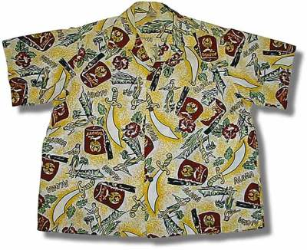
Demonstratives
On a separate sheet of paper, tell me why the clothing you are wearing is better than the one pictured. Use demonstrative words to clarify which you refer to.

Slide 29
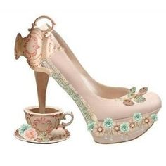
Demonstratives
On a separate sheet of paper, tell me why the clothing you are wearing is better than the one pictured. Use demonstrative words to clarify which you refer to.

Slide 30
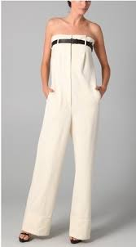
Demonstratives
On a separate sheet of paper, tell me why the clothing you are wearing is better than the one pictured. Use demonstrative words to clarify which you refer to.

Slide 31
Demonstratives
On a separate sheet of paper, tell me why the clothing you are wearing is better than the one pictured. Use demonstrative words to clarify which you refer to.

