Slide 1
Verbs in the Present Tense
(Los verbos en el tiempo presente)
First conjugation: -ar, -er, -ir

Slide 2
The fundamental parts of the Spanish verb
1
The infinitive: The basic, unconjugated form, the one that corresponds to the English “to do” (something). For example, to speak, to work, to sing, etc.
The Spanish infinitive always ends in r

Slide 3
The fundamental parts of the Spanish verb
The Spanish infinitive always ends in r
hablar
comer
escribir
cantar
aprender
leer
salir
conocer
costar
correr
finalizar
freír

Slide 4
The fundamental parts of the Spanish verb
2
The ending: The last two letters of the infinitive.
The ending always consists of two letters.

Slide 5
The fundamental parts of the Spanish verb
The ending always consists of two letters
hablar
comer
escribir
cantar
aprender
leer
hablar
comer
escribir
cantar
aprender
leer
salir
conocer
costar
correr
finalizar
freír
salir
conocer
costar
correr
finalizar
freír
ar
ir
er
er
ir
ar
ar
er
er
ar
er
ir
There are three types or categories of verbs in Spanish:
those that end in ar,
those that end in er,
and those that end in ir

Slide 6
The fundamental parts of the Spanish verb
3
The stem or root: Whatever is left after removing the ending from the infinitive.
The stem can consist of a variable number of letters, depending on the length of the verb in question.

Slide 7
The fundamental parts of the Spanish verb
The infinitive – the ending = the stem
hablar
comer
escribir
cantar
aprender
leer
salir
conocer
costar
correr
finalizar
freír

Slide 8
The fundamental parts of the verb
¡No te olvides!
Don't forget!
1
The infinitive: The basic, unconjugated form of the verb.
estudiar
2
The ending: The last two letters of the infinitive.
ar
3
The stem: What is left after taking the ending from the infinitive.
estudi

Slide 9
Verb Conjugation
To conjugate: To put a verb in its correct person and number so that we know who is doing the action.
When we conjugate any verb we always begin with its stem.

Slide 10
Verbs of the 1st conjugation (-ar)
The following verbs are regular -ar verbs and are conjugated according to the pattern in the following slides.
hablar
to speak
llegar
to arrive
ayudar
to help
mirar
to look at
bailar
to dance
nadar
to swim
buscar
to look for
necesitar
to need
caminar
to walk
preparar
to prepare
comprar
to buy
regresar
to return
conversar
to converse
tomar
to take or to drink
enseñar
to teach
escuchar
to listen
trabajar
to work
estudiar
to study
viajar
to travel

Slide 11
To form the present tense of -ar verbs:
STEM + Verb ending
Singular
yo
tú
él / ella /
Ud.
Plural
nosotros
vosotros
ellos / ellas /
Uds.
-o
-as
-a
-amos
-áis
-an

Slide 12
Verbs of the 1st conjugation (-ar)
hablar
All persons and numbers are based on the stem.
yo
nosotros/as
h
a
a
bl
o
habl
a
a
mos
tú
vosotros/as
h
a
a
bl
as
skip
Ud.
Uds.
h
a
a
bl
a
h
a
a
bl
an
él
ellos
ella
ellas
Notice which vowel gets the emphasis!

Slide 13
Verbs of the 1st conjugation (-ar)
trabajar
Its stem?
trab
a
a
j
o
trabaj
a
a
mos
trab
a
a
j
as
skip
trab
a
a
j
a
trab
a
a
j
an
The emphasis?

Slide 14
Verbs of the 1st conjugation (-ar)
buscar
Its stem?
b
u
u
sc
o
busc
a
a
mos
b
u
u
sc
as
skip
b
u
u
sc
a
b
u
u
sc
an

Slide 15
Verbs of the 1st conjugation (-ar)
estudiar
Its stem?
est
u
u
di
o
estudi
a
a
mos
est
u
u
di
as
skip
est
u
u
di
a
est
u
u
di
an

Slide 16
To form the present tense of er verbs:
STEM + Verb ending
Singular
yo
tú
él / ella /
Ud.
Plural
nosotros
vosotros
ellos / ellas /
Uds.
-o
-es
-e
-emos
Skip
-en

Slide 17
To form the present tense of -ir verbs:
STEM + Verb ending
Singular
yo
tú
él / ella /
Ud.
Plural
nosotros
vosotros
ellos / ellas /
Uds.
-o
-es
-e
-imos
Skip
-en

Slide 18
Beber: to drink
Write these down on your chart!
beb
er
beb
beb
beb
o
es
e
beb
skip
beb
emos
en

Slide 19
Comer: to eat
Write these down on your chart!
com
er
com
com
com
o
es
e
com
skip
com
emos
en

Slide 20
escribir: to write
Write these down on your chart!
escrib
ir
escrib
escrib
escrib
o
es
e
escrib
skip
escrib
imos
en

Slide 21
-AR -ER -IR
Yo Tú Ud./él/ella nosotros(as)
vosotros(as) Uds/ellos/ellas
Habl-o | Com-o | Viv-o
Habl-as | Com-es | Viv-es
Habl-a | Com-e | Viv-e
Habl-amos | Com-emos | Viv-imos
skip | skip | skip
Habl-an | Com-en | Viv-en

Slide 22
Verb usage
The Spanish present indicative tense has several equivalents in English.
As in English, it can express present habitual actions:
Estudiamos español en la universidad.
We study Spanish at the university.
But, unlike English, it can also express ongoing actions:
En este momento estudiamos en la biblioteca.
Right now we’re studying in the library.
It can even express future actions:
Esta noche estudiamos para el examen.
Tonight we will study for the exam.

Slide 23
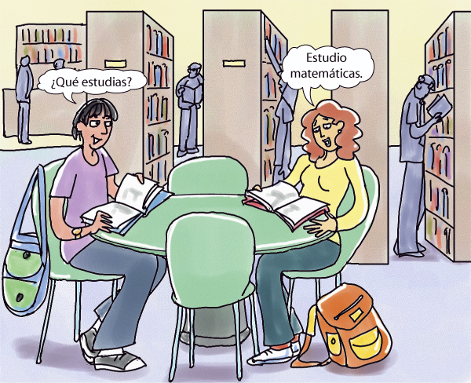
La biblioteca es un buen lugar para estudiar.
Estudio matemáticas.
¿Qué estudias?
Verb forms that refer to people that are within the conversation flip to their “opposite” form.
estudio estudiamos
estudias estudiáis
estudia estudian
¿Qué estudias tú?

Slide 24
La biblioteca es un buen lugar para estudiar.
Estudia filosofía.
¿Qué estudia Juan?
Verb forms that refer to people that are outside the conversation do not change.
estudio estudiamos
estudias estudiáis
estudia estudian

Slide 25
FIN

