Slide 1
Adj Agreement Día 1
Differences between adjectives in English and Adjectives in Spanish
1. In Spanish, adjectives go after the thing they describe
Old car → Carro Viejo
Hombre
+
Alto
=__________ ___________
Hombre
Alto
Notes:
Hit #8 Activating Prior Knowledge

Slide 2
Adj Agreement Día 1
Differences between adjectives in English and Adjectives in Spanish
1. In Spanish, adjectives go after the thing they describe
Old car → Carro Viejo
Guapa
+
Chica
=__________ ___________
Chica
Guapa
Notes:
Hit #8 Activating Prior Knowledge

Slide 3
Adj Agreement Día 1
Differences between adjectives in English and Adjectives in Spanish
1. In Spanish, adjectives go after the thing they describe
Cómico
+
jugo
=__________ ___________
Jugo
cómico
Notes:
Hit #8 Activating Prior Knowledge

Slide 4
In Spanish, adjectives agree in gender and number with what they describe.
Adj. that end in -e match both genders.
Some adj. ending in a consonant add -a to the feminine. (trabajadora)
To make an adj. plural, add -es if it ends in a consonant
 | Singular | Plural
Masculine | Generally ends -o | Generally ends -os
Feminine | Generally ends -a | Generally ends -as
Notes:
Hit #8 Activating Prior Knowledge

Slide 5
Adj Agreement Día 1
***Adj. in your book are usually just given as masculine singular and you must change them***
 | Singular | Plural
Masculine | Generally ends -o | Generally ends -os
Feminine | Generally ends -a | Generally ends -as
Chico
+
Bajo
=
Chico bajo
Notes:
Hit #8 Activating Prior Knowledge

Slide 6
Adj Agreement Día 1
***Adj. in your book are usually just given as masculine singular and you must change them***
 | Singular | Plural
Masculine | Generally ends -o | Generally ends -os
Feminine | Generally ends -a | Generally ends -as
Chica
+
Bajo
=
Chica baja
Notes:
Hit #8 Activating Prior Knowledge

Slide 7
Adj Agreement Día 1
***Adj. in your book are usually just given as masculine singular and you must change them***
 | Singular | Plural
Masculine | Generally ends -o | Generally ends -os
Feminine | Generally ends -a | Generally ends -as
Chicos
+
Bajo
=
Chicos bajos
Notes:
Hit #8 Activating Prior Knowledge

Slide 8
Adj Agreement Día 1
***Adj. in your book are usually just given as masculine singular and you must change them***
 | Singular | Plural
Masculine | Generally ends -o | Generally ends -os
Feminine | Generally ends -a | Generally ends -as
Chicas
+
Bajo
=
Chicas bajas
Notes:
Hit #8 Activating Prior Knowledge

Slide 9
Adj Agreement Día 1
***Adj. in your book are usually just given as masculine singular and you must change them***
 | Singular | Plural
Masculine | Generally ends -o | Generally ends -os
Feminine | Generally ends -a | Generally ends -as
Lazy man
=
Hombre perezoso
Notes:
Hit #8 Activating Prior Knowledge

Slide 10
Adj Agreement Día 1
***Adj. in your book are usually just given as masculine singular and you must change them***
 | Singular | Plural
Masculine | Generally ends -o | Generally ends -os
Feminine | Generally ends -a | Generally ends -as
Red-headed woman
=
Mujer pelirroja
Notes:
Hit #8 Activating Prior Knowledge

Slide 11
Adj Agreement Día 1
***Adj. in your book are usually just given as masculine singular and you must change them***
 | Singular | Plural
Masculine | Generally ends -o | Generally ends -os
Feminine | Generally ends -a | Generally ends -as
Funny pizzas
=
Pizzas cómicas
Notes:
Hit #8 Activating Prior Knowledge

Slide 12
Adj Agreement Día 1
***Adj. in your book are usually just given as masculine singular and you must change them***
 | Singular | Plural
Masculine | Generally ends -o | Generally ends -os
Feminine | Generally ends -a | Generally ends -as
The old french fries
=
Las papas fritas viejas
Notes:
Hit #8 Activating Prior Knowledge

Slide 13
Adj Agreement Día 1
***Adj. in your book are usually just given as masculine singular and you must change them***
 | Singular | Plural
Masculine | Generally ends -o | Generally ends -os
Feminine | Generally ends -a | Generally ends -as
A small cookie
=
Una galleta pequeña
Notes:
Hit #8 Activating Prior Knowledge

Slide 14
Adj Agreement Día 1
***Adj. in your book are usually just given as masculine singular and you must change them***
 | Singular | Plural
Masculine | Generally ends -o | Generally ends -os
Feminine | Generally ends -a | Generally ends -as
The organized boys
=
Los chicos organizados
Notes:
Hit #8 Activating Prior Knowledge

Slide 15
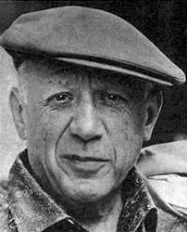
Adj Agreement Día 1
Raise your hand and describe the people below. Adjectives that might work are listed, as well.
Possibilities:
Artistic
Intelligent
Old
Hombre artistico
Hombre inteligente
Hombre viejo
Pablo Picasso
Notes:
Hit #8 Activating Prior Knowledge

Slide 16
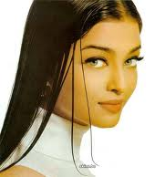
Adj Agreement Día 1
Raise your hand and describe the people below. Adjectives that might work are listed, as well.
Possibilities:
Artistic
Young
Pretty
Mujer artística
Mujer joven
Mujer bonita
Aishwarya Rai
Notes:
Hit #8 Activating Prior Knowledge

Slide 17
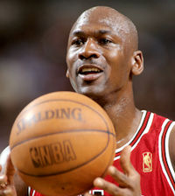
Adj Agreement Día 1
Raise your hand and describe the people below. Adjectives that might work are listed, as well.
Possibilities:
Athletic
Hard working
Tall
Good-looking
Hombre atlético
Hombre trabajador
Hombre alto
Hombre guapo
Michael Jordan
Notes:
Hit #8 Activating Prior Knowledge

Slide 18
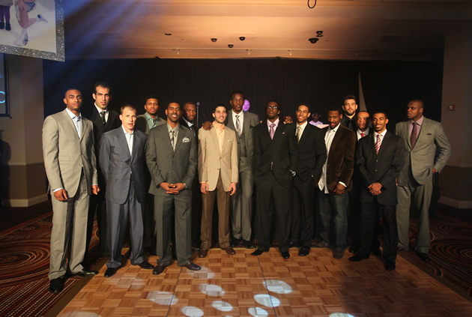
Adj Agreement Día 1
Raise your hand and describe the people below. Adjectives that might work are listed, as well.
Possibilities:
Athletic
Hard working
Tall
Young
Hombres atléticos
Hombres trabajadores
Hombres altos
Hombres jovenes
The Memphis Grizzlies
Notes:
Hit #8 Activating Prior Knowledge

Slide 19
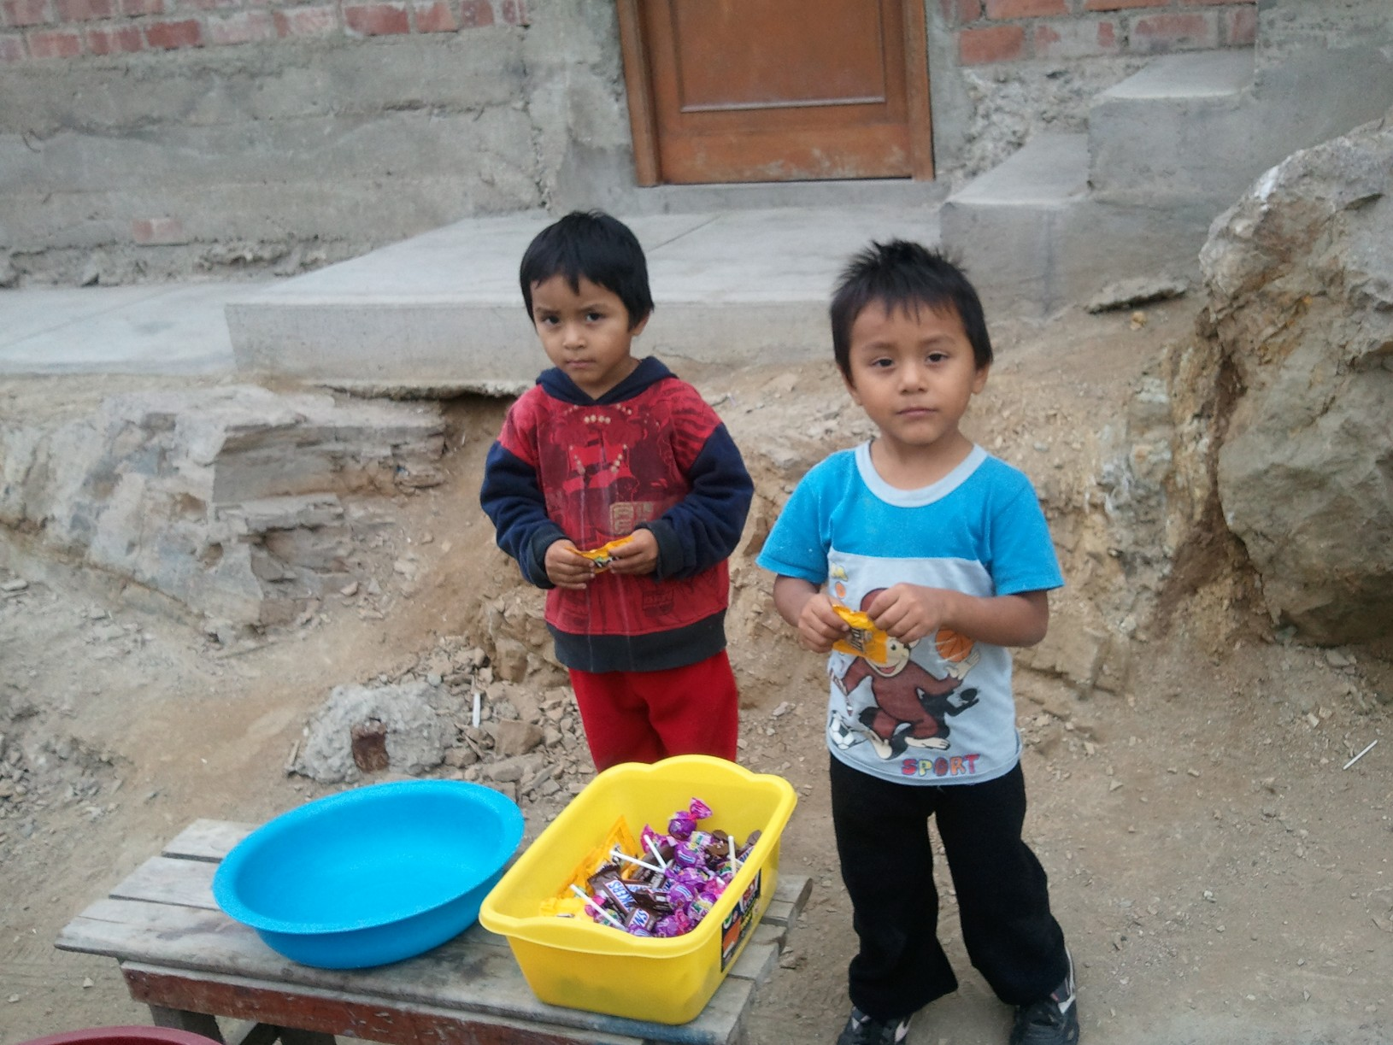
Adj Agreement Día 1
Raise your hand and describe the people below. Adjectives that might work are listed, as well.
Possibilities:
Short
Young
Personas bajas
Personas jovenes
PEOPLE
Notes:
Hit #8 Activating Prior Knowledge

Slide 20
Adj Agreement Día 1
Independently, complete “Did you get it” pg 46
On the way out, get this worksheet into the classwork tray.
Notes:
Hit #8 Activating Prior Knowledge

